Slide 1
"Women & Photography"
Diane Arbus
Name: Miriam Martín
Teacher: Rosa Borrell

Slide 2
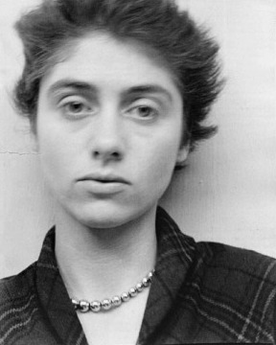
Diane Arbus.
She was born on March 14, 1923 in New York City and died on July 26, 1971 at the aged of 48 because she committed suicide.

Slide 3
In 1972, a year after she committed suicide, Arbus became the first American photographer to have photographs displayed at the Venice Biennale . Millions of people viewed traveling exhibitions of her work in 1972-1979. In 2003-2006, Arbus and her work were the subjects of another major traveling exhibition, Diane Arbus Revelations . In 2006, the motion picture Fur , starring Nicole Kidman as Arbus, presented a fictional version of her life story.
Although some of Arbus's photographs have sold for hundreds of thousands of dollars at auction, Arbus's work has provoked controversy.

Slide 4
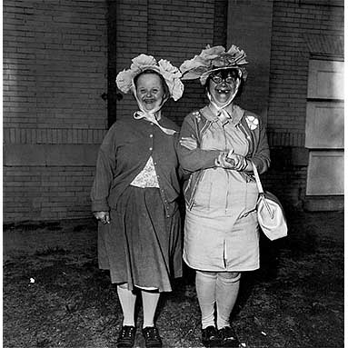
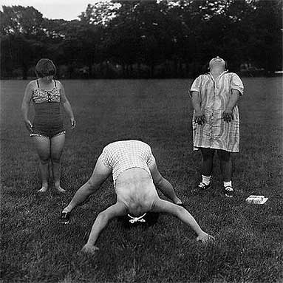
She was an American photographer and writer noted for black-and-white square photographs of "deviant and marginal people or of people whose normality seems ugly, like this:

Slide 5
Death
Arbus experienced "depressive episodes" during her life similar to those experienced by her mother, and the episodes may have been worsened by symptoms of hepatitis. Arbus wrote in 1968 "I go up and down a lot," and her ex-husband noted that she had "violent changes of mood." On July 26, 1971, while living at Westbeth Artists Community in New York City, Arbus took her own life by ingesting barbiturates and slashing her wrists with a razor.Marvin Israel found her body in the bathtub two days later; she was 48 years old.

Slide 6
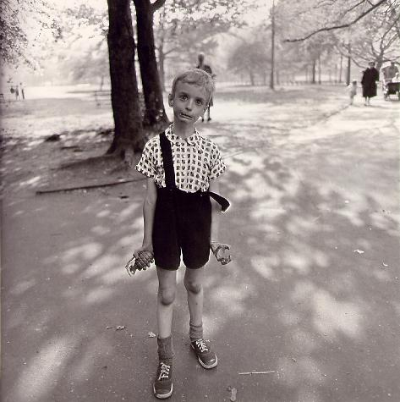
Notable photographs
Child with Toy Hand Grenade in Central Park, N.Y. 1962 Colin Wood, with the left strap of his jumper awkwardly hanging off his shoulder, tensely holds his long, thin arms by his side. Clenching a toy grenade in his right hand and holding his left hand in a claw-like gesture, his facial expression is maniacal. A print of this photograph was sold in 2005 at auction for $408,000.

Slide 7
